Slide 1
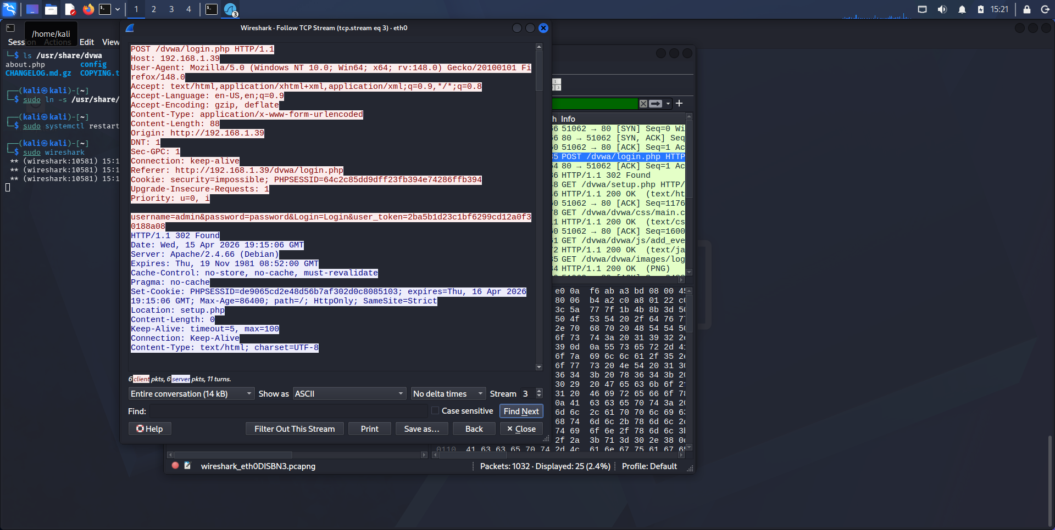
Dvwa

Slide 2
WHY ENCRYPTION ABSENCE IS DANGEROUS
FTP. Credentials are in plaintext and files can be modified in transit without detection.
Telnet. All characters are sent as separate packet in plaintext. Enables command injection
HTTP/DVWA. Login credentials are sent in the POST body. Session cookies can be stolen

